Slide 1
Samuel Sisay Professor Jesse Bemley CTEC 298 Bid Data project Data 03/10/2022

Slide 2
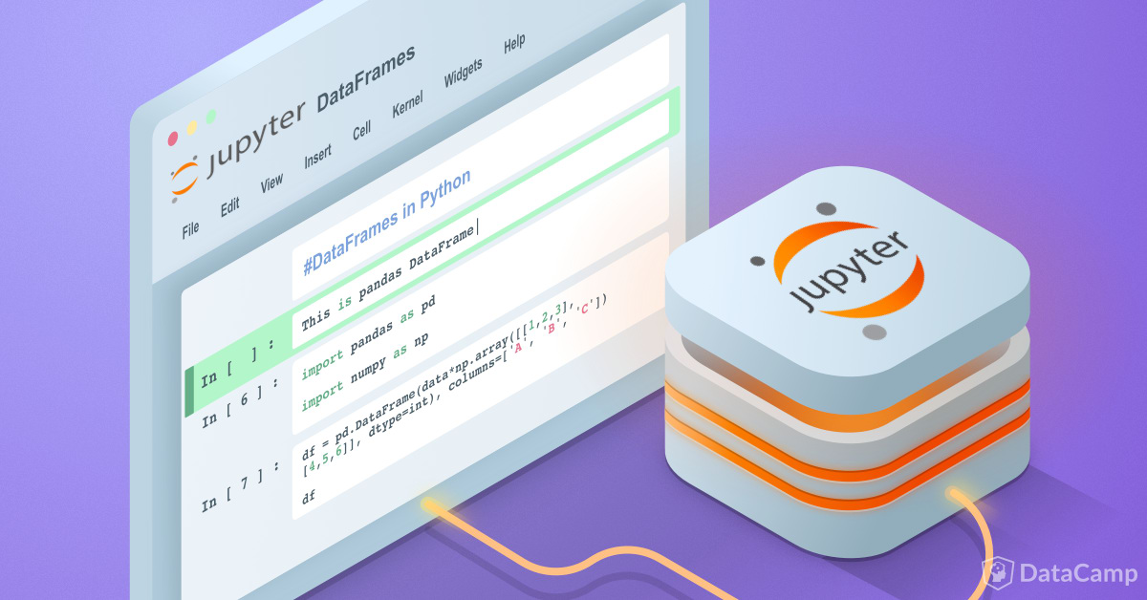
Introduction
Installing Python ​and understand the fundamentals of programming in Python.
Cover the basics of installing Jupyter and creating the first Jupyter notebook program.
Purposes of using Jupyter notebook​.
Using Jupyter notebook to visualize and analysis for ctec128 data file.
Plotting six different charts on Jupyter notebook
Collect different types of data file like text files, csv files and excel sheet.
Focus on plot legends and text, titles, axes labels
Purposes of using DataFrames in Pandas
The purpose of using GitHub
Purpose of using Google drive.
Summery

Slide 3

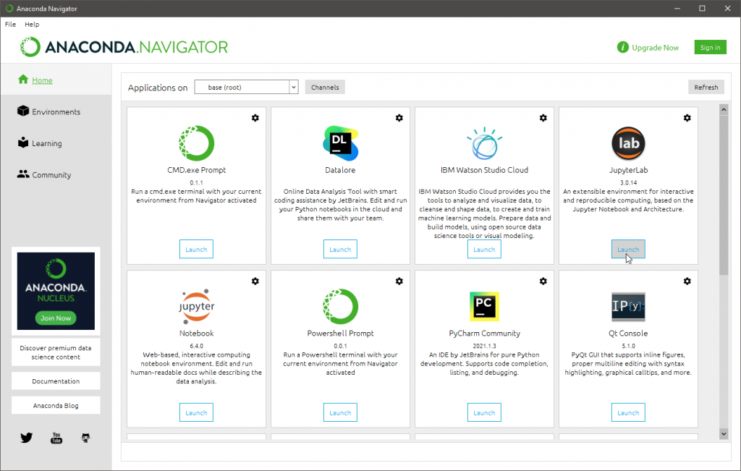
The first step is download Anaconda Navigator.
Select the preferable plateform to use you to visualize your data.
CTEC 298 class (Big Data) is more focused on Jupyter notebook platform.

Slide 4
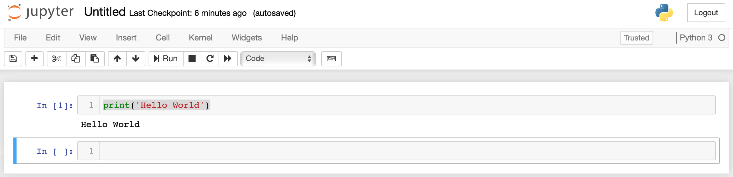
Now, the first step is to run the code:
Imports in Python are important for structuring code effectively.
Using imports properly will make more productive, allowing
Using imports properly to reuse code while keeping projects maintainable
we have to import python liybrary
Import pandas as pd
Import numpy as np
Import matplotlib.pyplot as plt
Once import liyberary, test Hello world as you can see in figure.

Slide 5
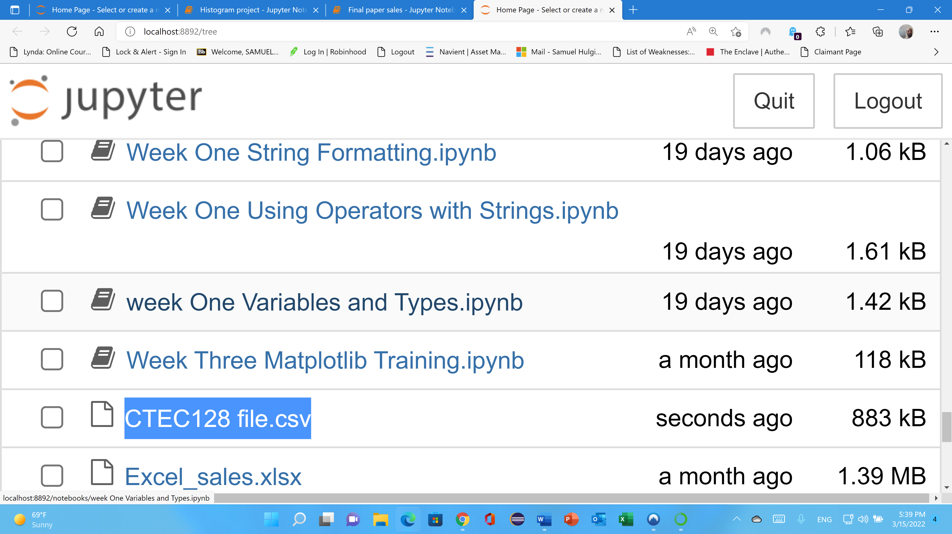
Adding file on jupyter notebookhe first steps.
Flat files
Text files
CSV files
Excel sheet
For example, figure shows that CTEC 128 data file uploaded as csv file on jupyter notebook.

Slide 6
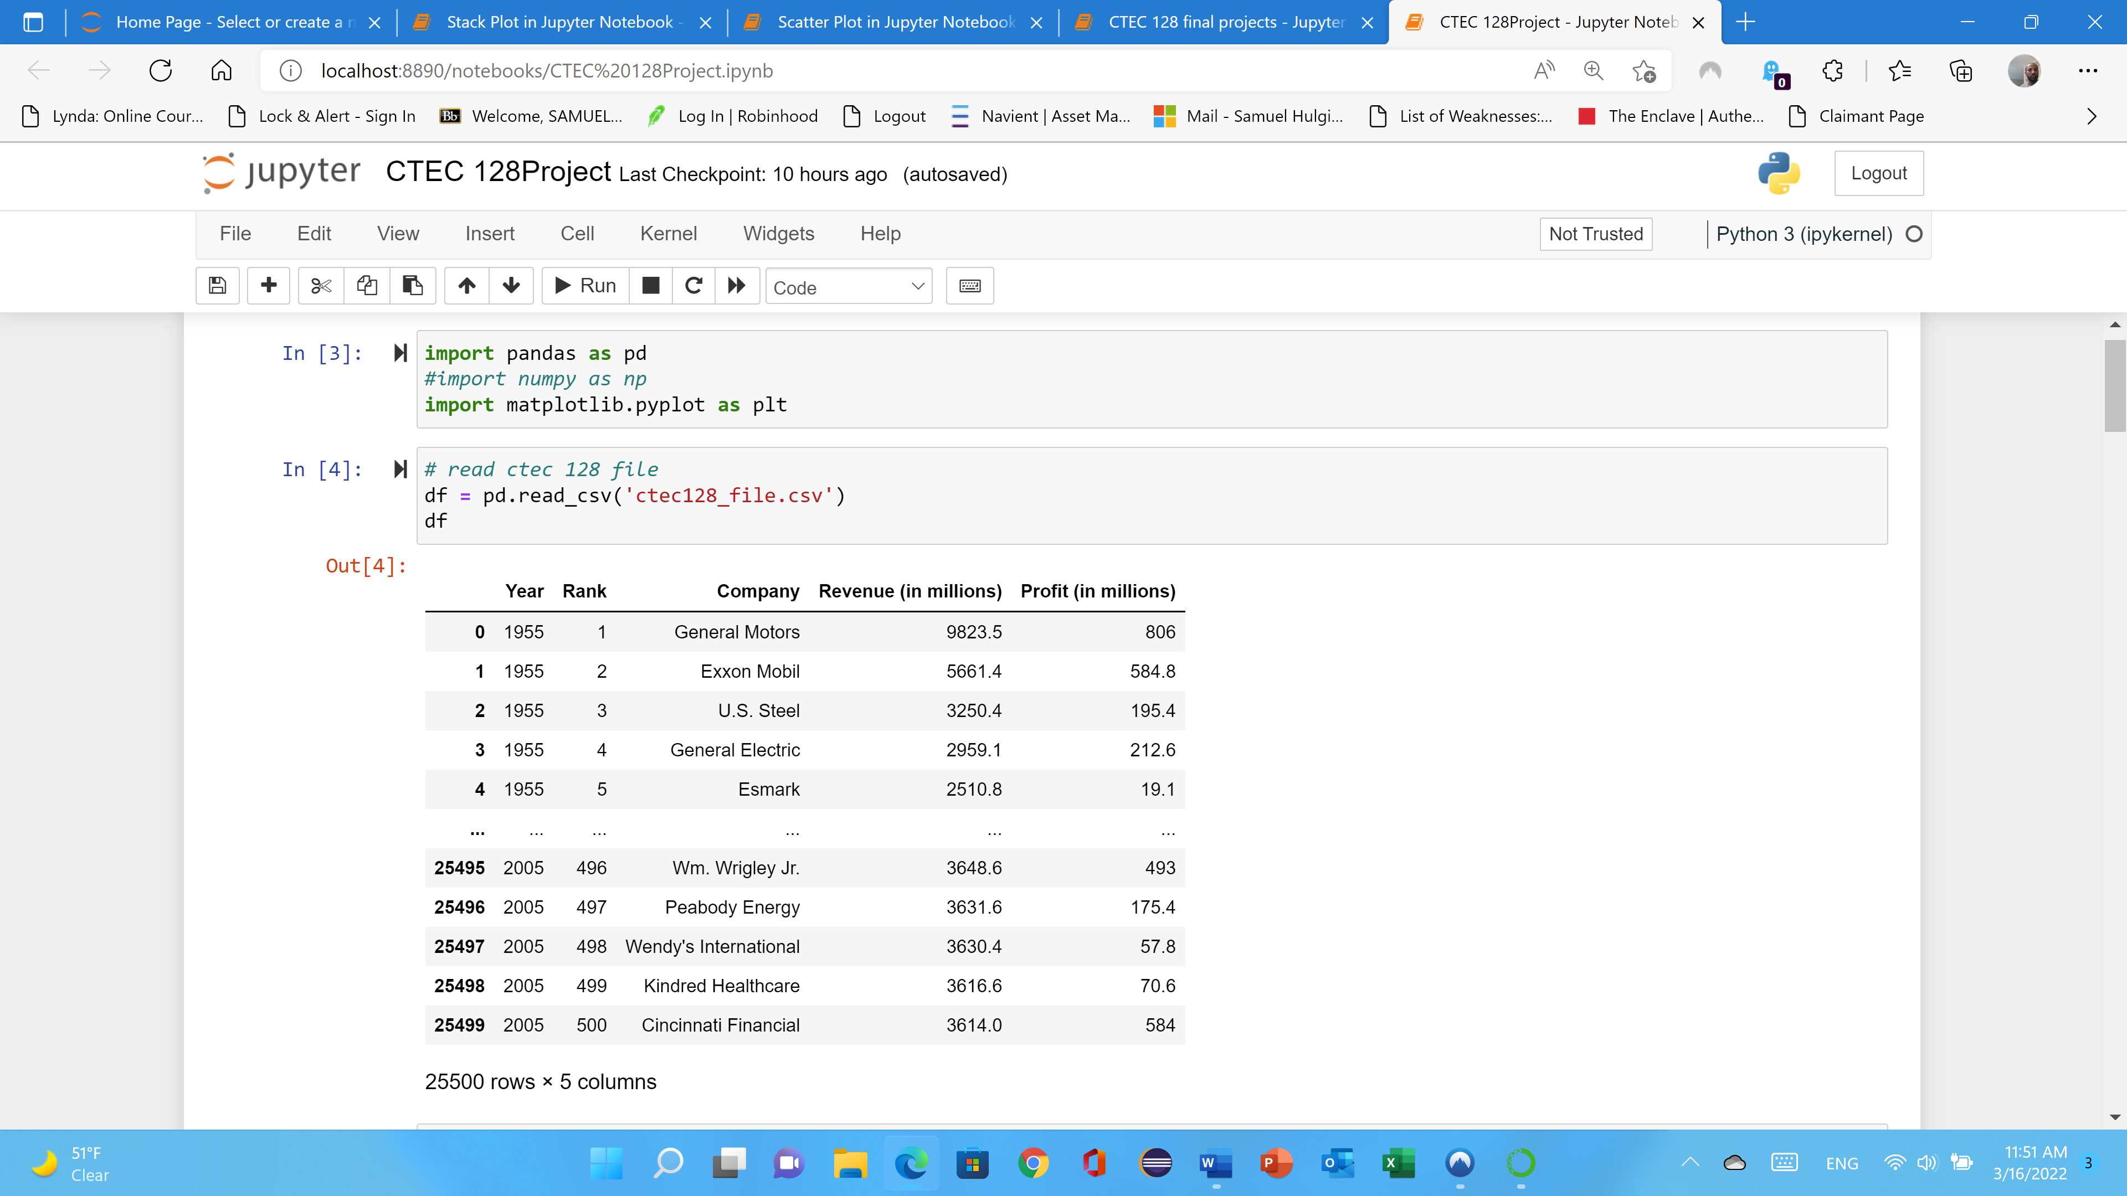
On figure shows that the CTEC 128 data file has been extracted or executed the file.
Its show that the file extracted data file from the jupyter notebook.
You can check as df and when you run it will show the first five rows and the last five rows.

Slide 7
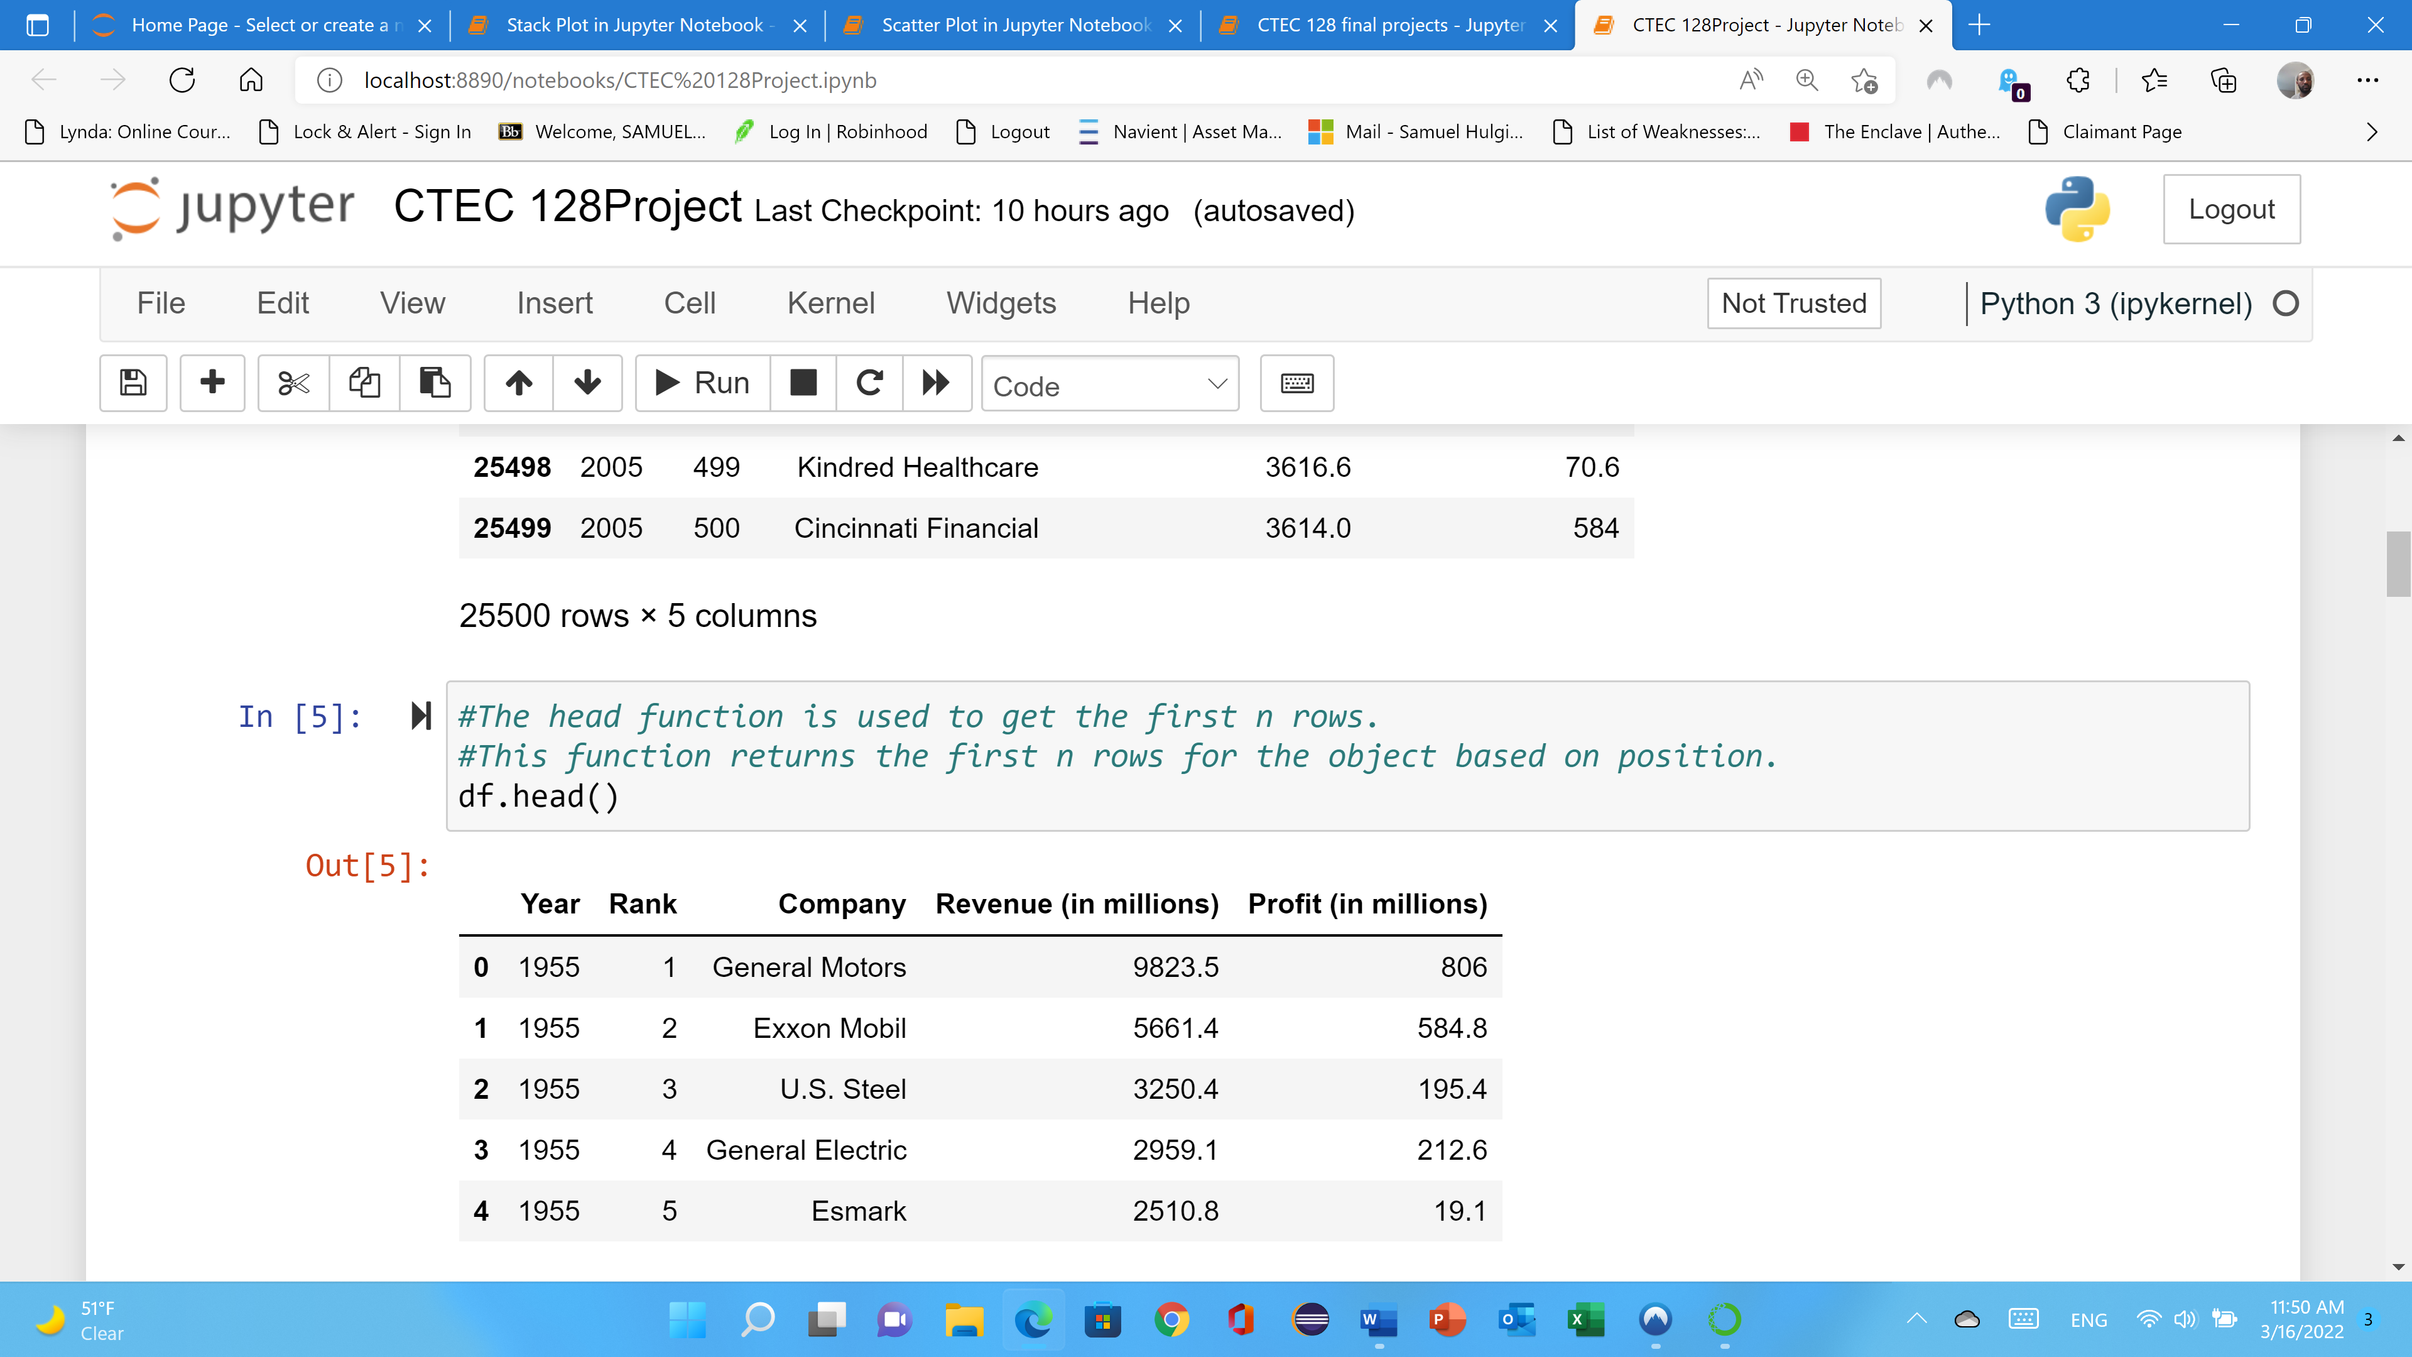
Figure shows that the file contains a large amount of data on jupyter notebook
It will not extract all of it
Since the data is large, we can specify it how many data file we have to execute.
For example:
df.head ()
In this case jupyter notebook will extract five data file headings by default.
If you want to extract more than five files, you may insert a value between the parenthesis to change the number of rows returned.

Slide 8
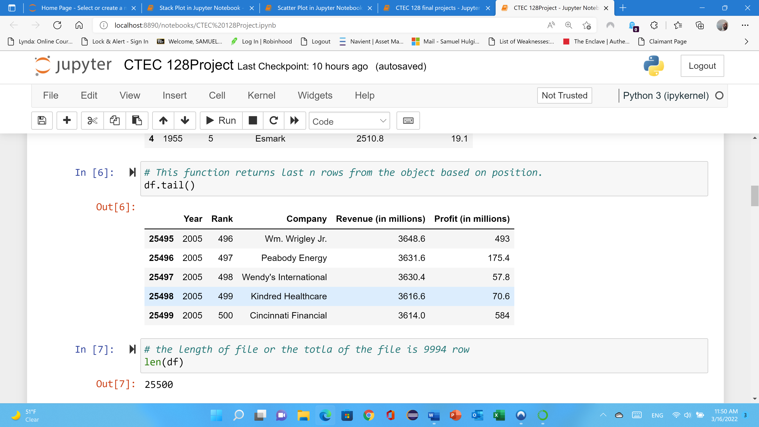
Figure shows that the file contains a large amount of data on jupyter notebook
It will not extract all of it but when you use df.tail() it will shows the last part of the file.
For example:
df.tail ()
In this case jupyter notebook will extract five data file headings by default.
If you want to extract more than five files, you may insert a value between the parenthesis to change the number of rows returned.

Slide 9
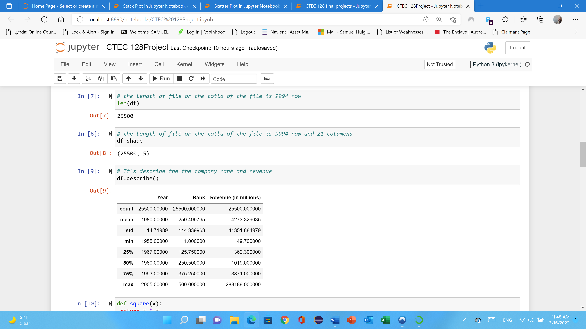
CTEC 128 data file extracts or transform a data set into a juypter notebook,
It is vital to know the size of the data file.
As a result, you can run len(df) in Jupyter notebook to find out the length of the data file.
It provides several techniques for identifying both rows and columns, which is "df.shap."
The following figure is visualizing each:
The min, max, std and count for each column for CTEC 128 file.

Slide 10
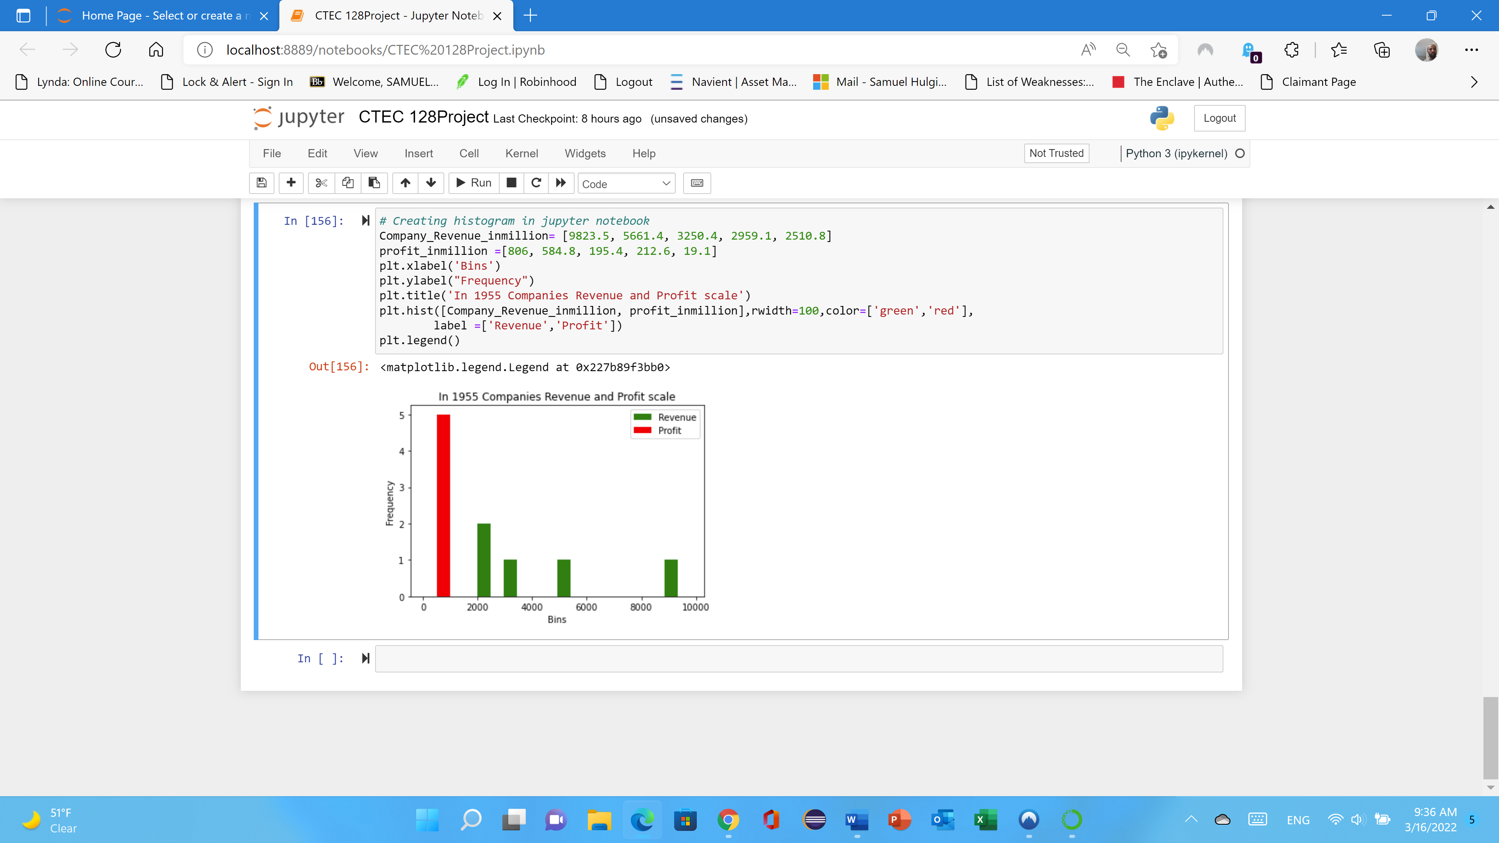
Histogram Chart
A Histogram is a bar graph of frequency distribution of quantitative data the horizontal axis is a number line.
This Histogram graph is 1955 in CTE 128 data file
The graph shows that the company revenue in million
The company profit in million level shows with red and green colors
Red is profit level is high
Green is also the company’s revenue.

Slide 11
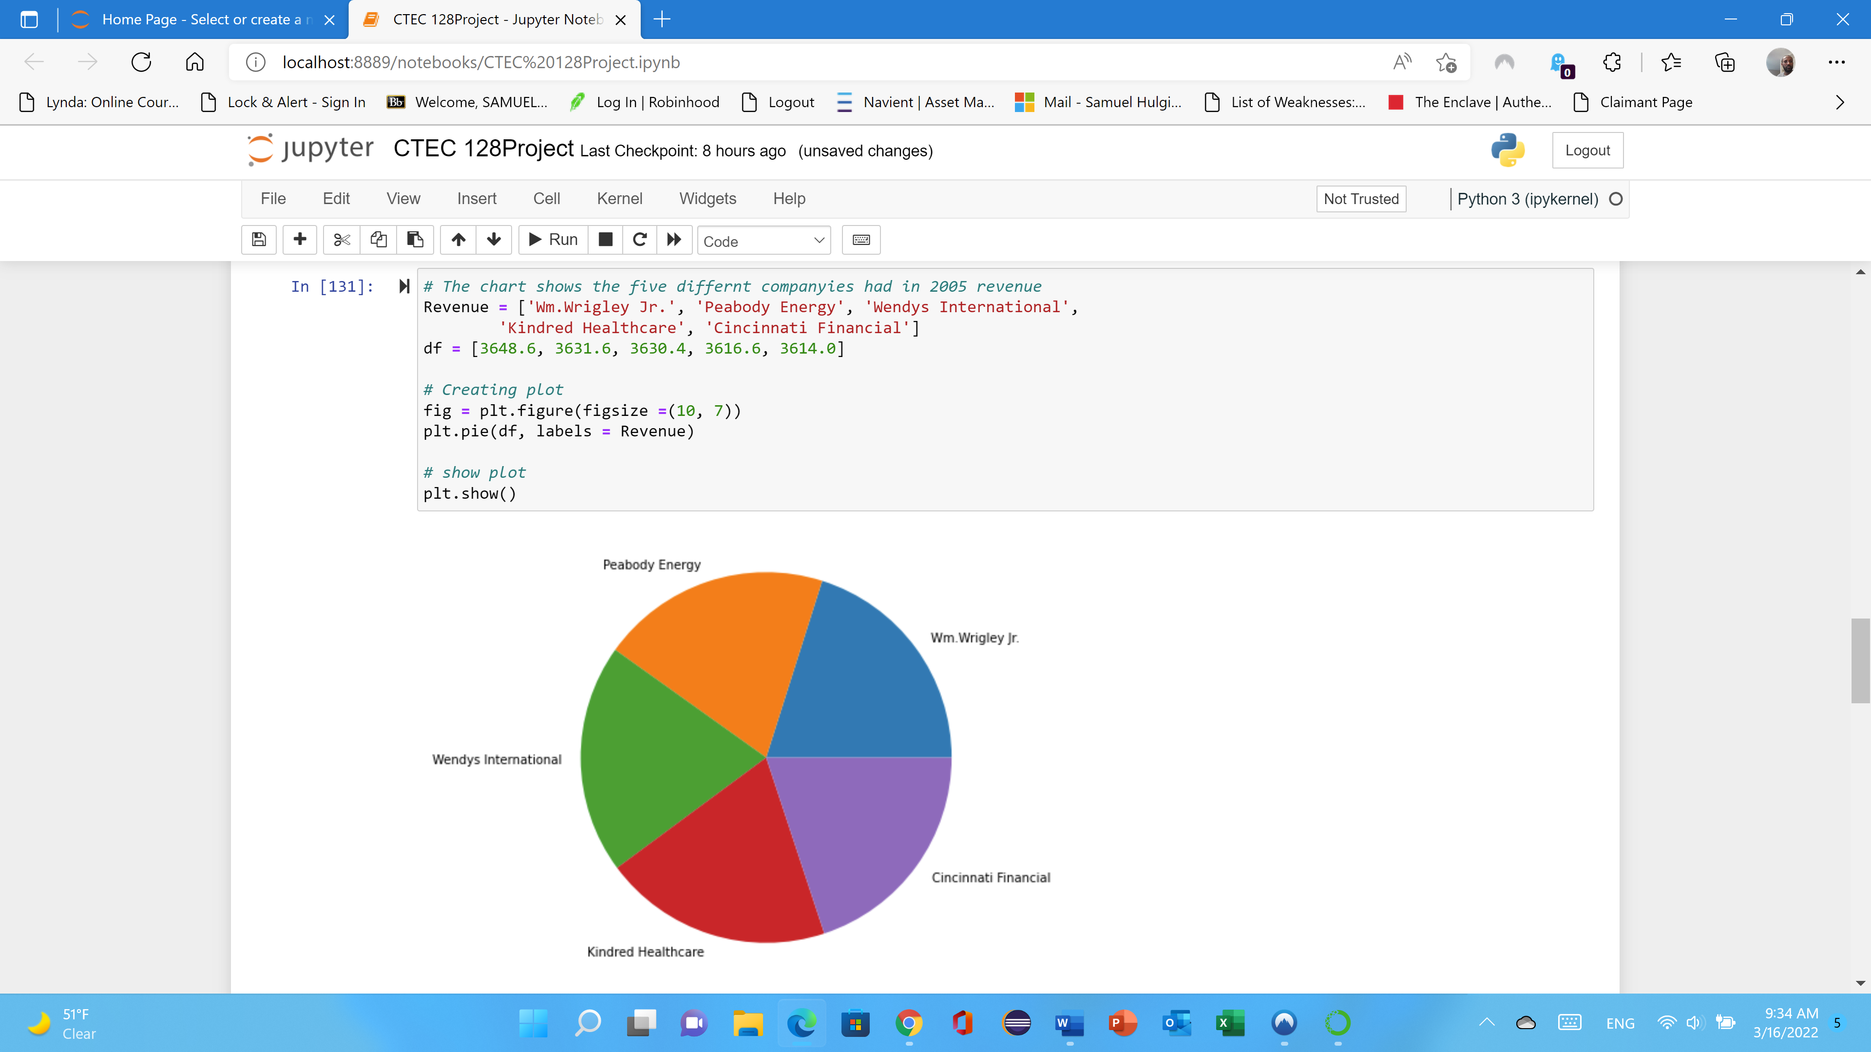
Pie Chart
The Pie chart shows a category is in relation to the whole.
It can only be used to display qualitative data. Therefore, during this project.
I have used CTEC 128 data file to explain in Pie chart five different companies' revenue and profit in 1955.
Here is the following the code and pie chart.

Slide 12
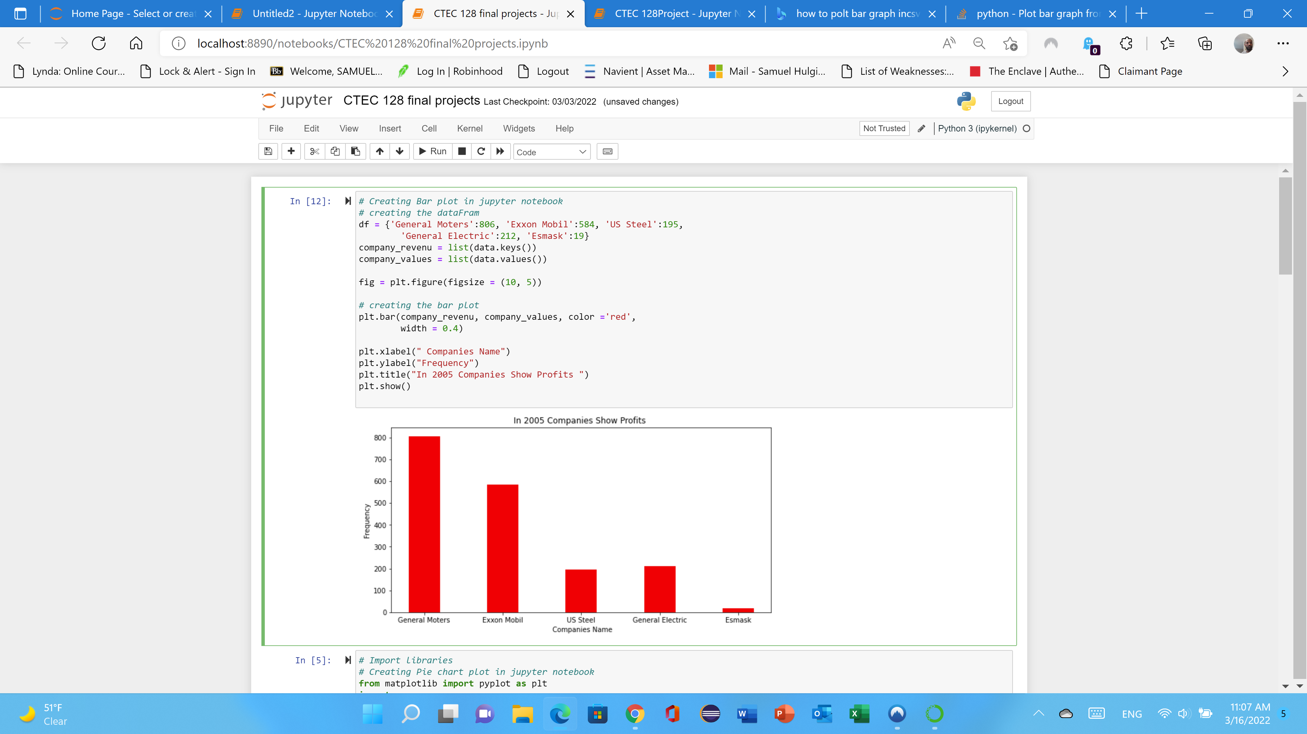
Bar Chart
In a bar graph, bars are used to represent the amount of data in each category.
One axis displays the categories of qualitative data, and the other axis displays the frequencies.
Bar graphs are used to compare things between different groups or to track changes over time.
However, when trying to measure change over time, bar graphs are best when the changes are larger.
This graph visualize the company revenue and profit.
The code is as follow…

Slide 13
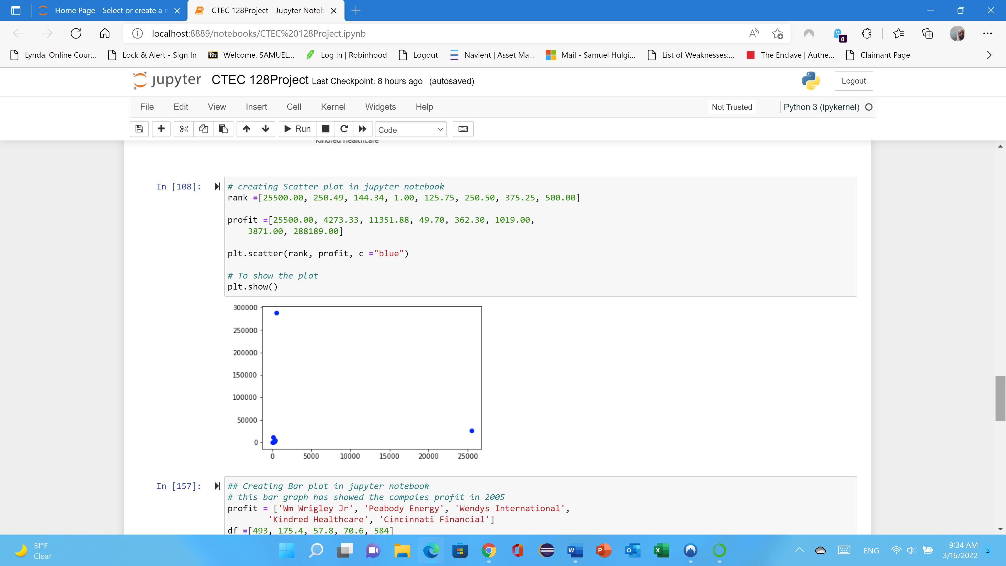
Scatter Chart
The primary purpose of a scatter plot is to show the relationship between two variables.
The marked dots show both the value of the data point and the overall pattern found on the data.
The following figure (scatter) shows that each company ranks, and their profit extracted from CTEC 128 data file.

Slide 14
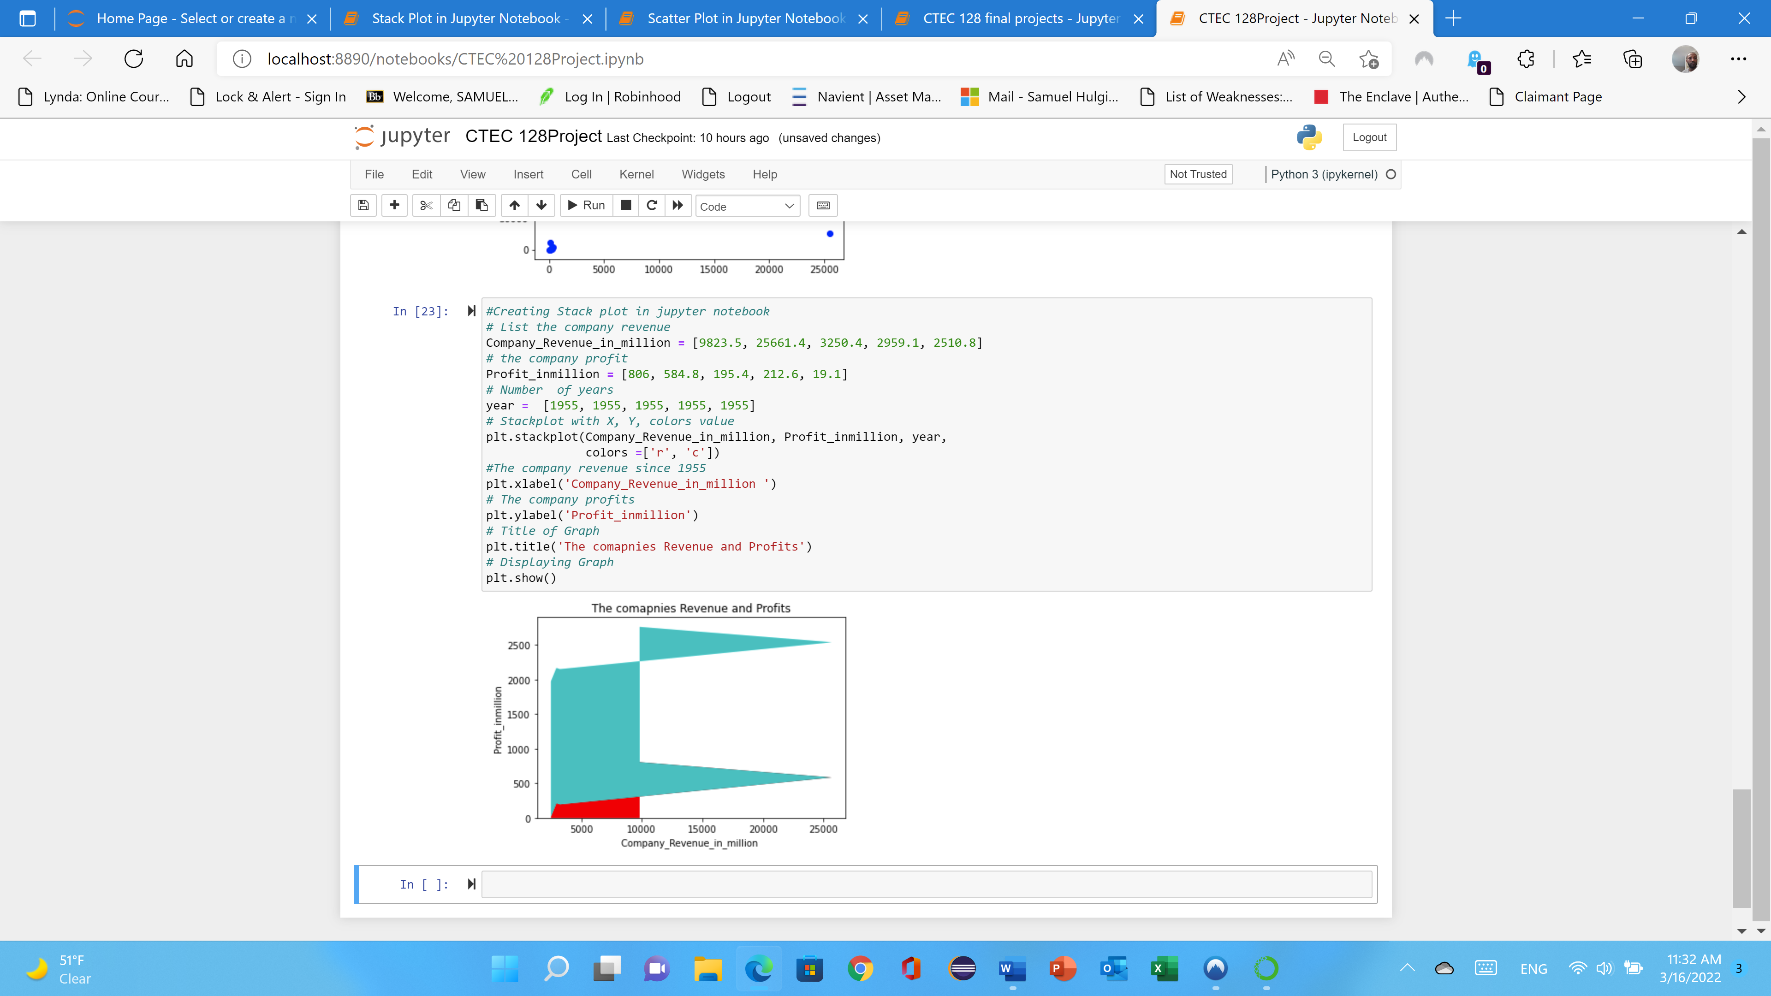
Stack Chart plot
A line graph uses straight lines to connect points plotted at the value of each measurement above the time it was taken.
The profit shows that from 57.8 to 806 scale that shows blue colors.
The company revenues shows that green color which is the revenue shows that more than two thousand five hundred dollars.
The company profit shows according to the stack chart is under twenty dollars which is showing that red color for each company is begin with under three thousands. See the graph….

Slide 15
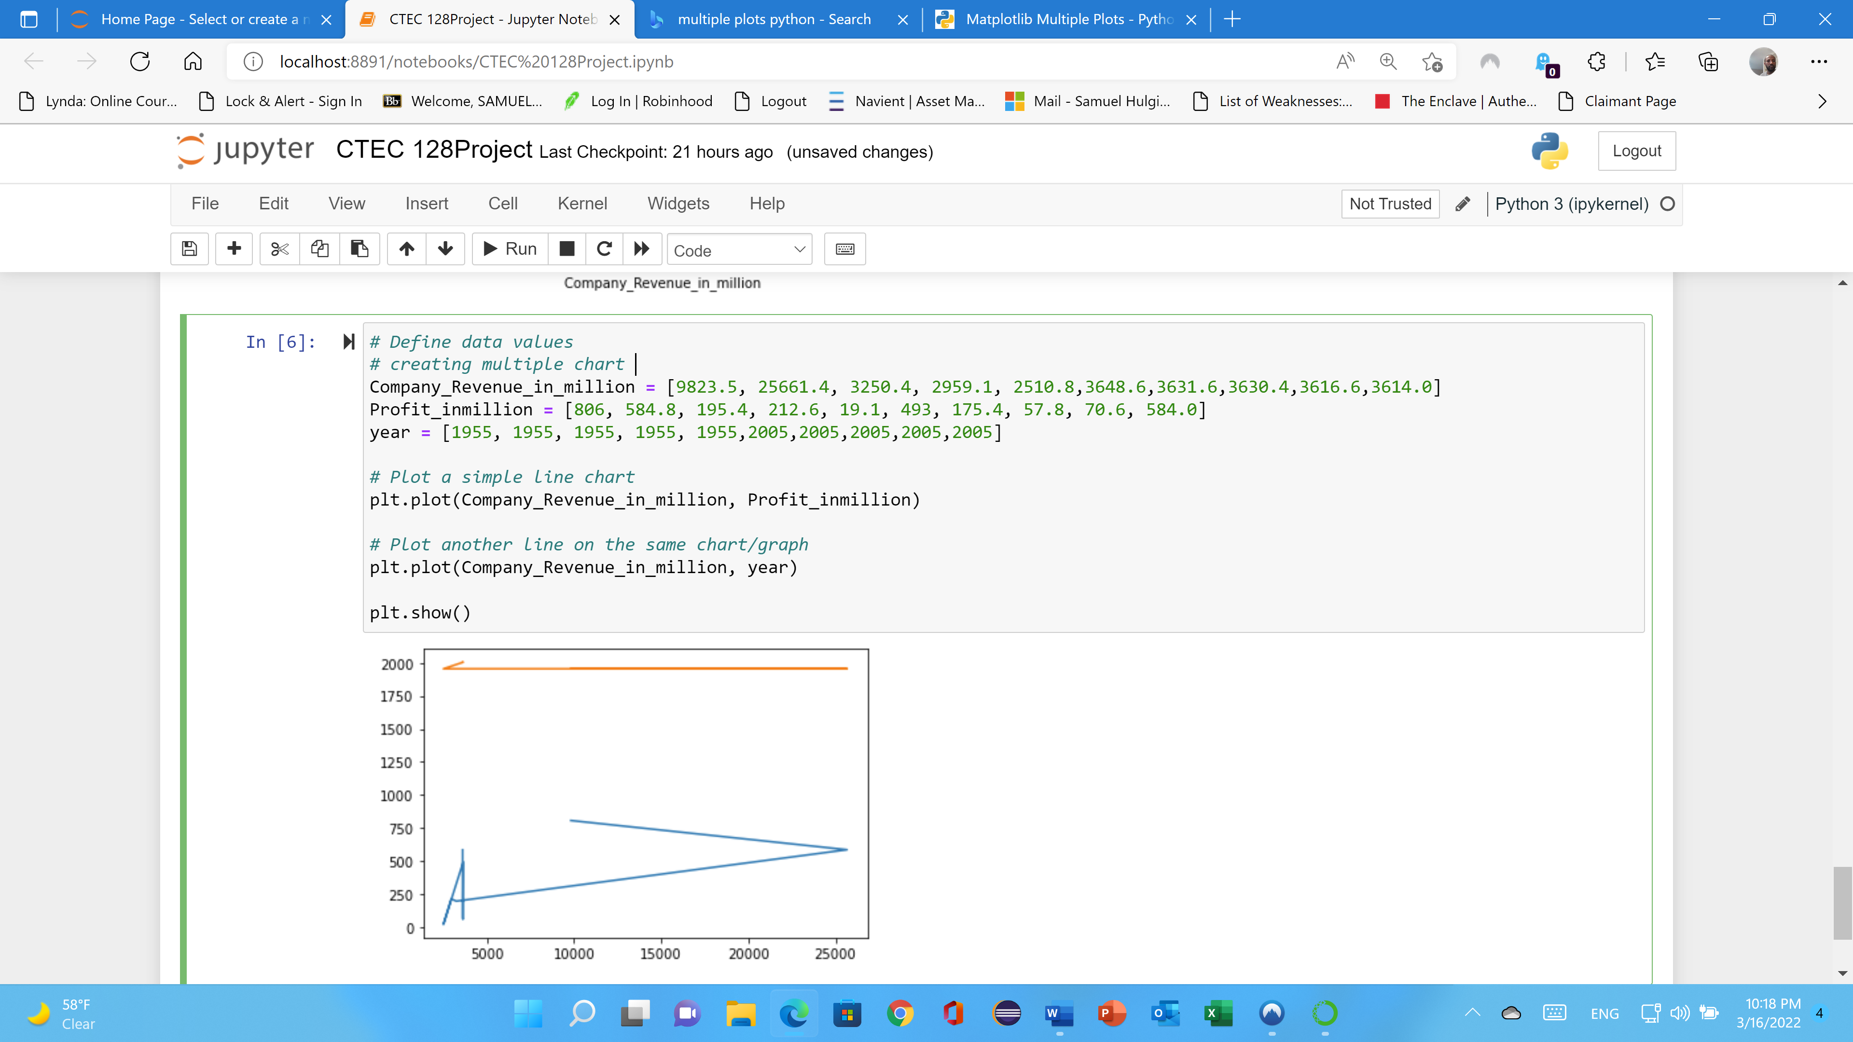
Multiplot
Multiplot is often required either for comparing the two curves
Show some gradual changes in the multiple plots, and this can be done using subplots.
The data file (CTEC 128) creating company revenue in million and profits each year to comparing or visualizing for five year which is 1955.
The profit shows that from 57.8 to 806 scale that shows blue colors.
The company revenues shows that orange color that the lower revenue for each company is begin with under three thousands. See the graph….

Slide 16
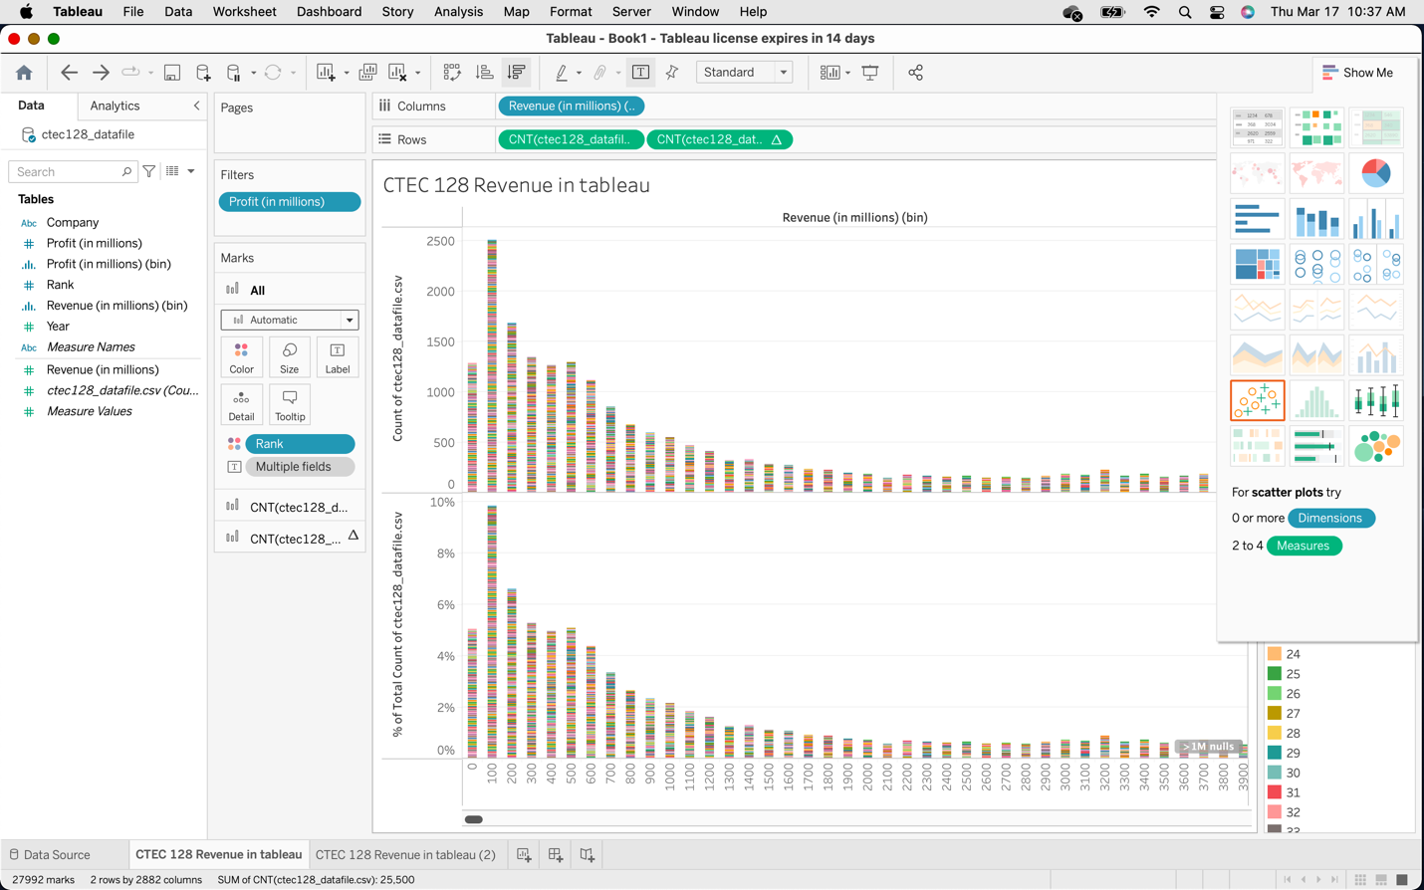
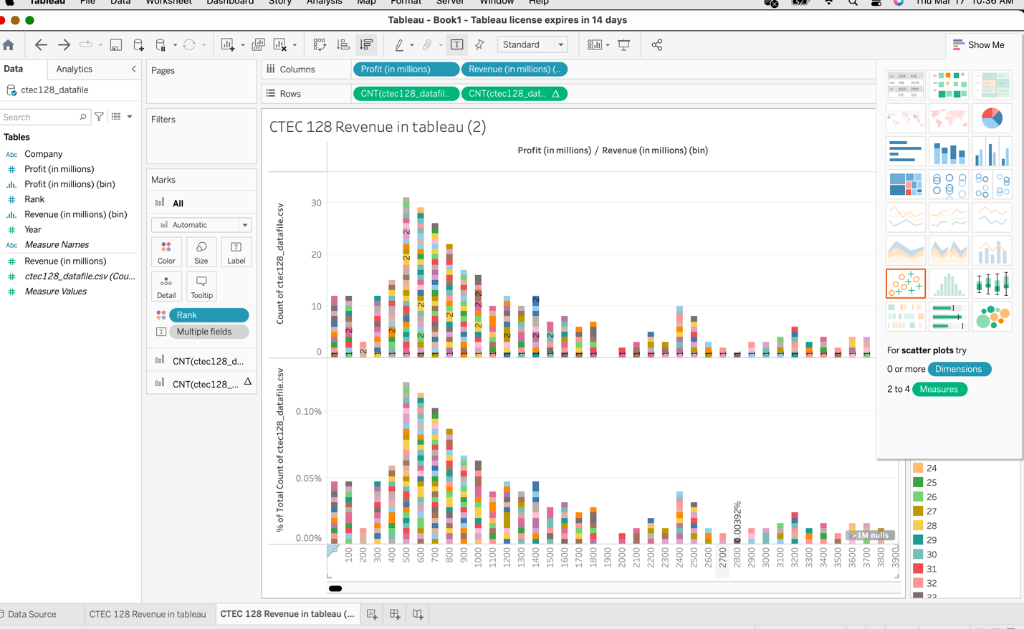
Tableau
You can quickly highlight differences between categories, show trends and outliers, and reveal historical highs and lows briefly.
Bar charts are simple, yet effective, especially when you have data that can be split into many categories.
Visualization helps people to understand things clearly and have a better insight into the topic.
Data visualization lets people know where they need to do an adjustment in their business to get a better result.
The following graph shows that how the CTEC 128 data file use on Tableau.
Once I have downloaded the application, I have uploaded the data and comparing or visualizing each companies profit and revenue as well as rank since 1955 to 2005.
I have two screenshots to identify each company profits and revenue

Slide 17
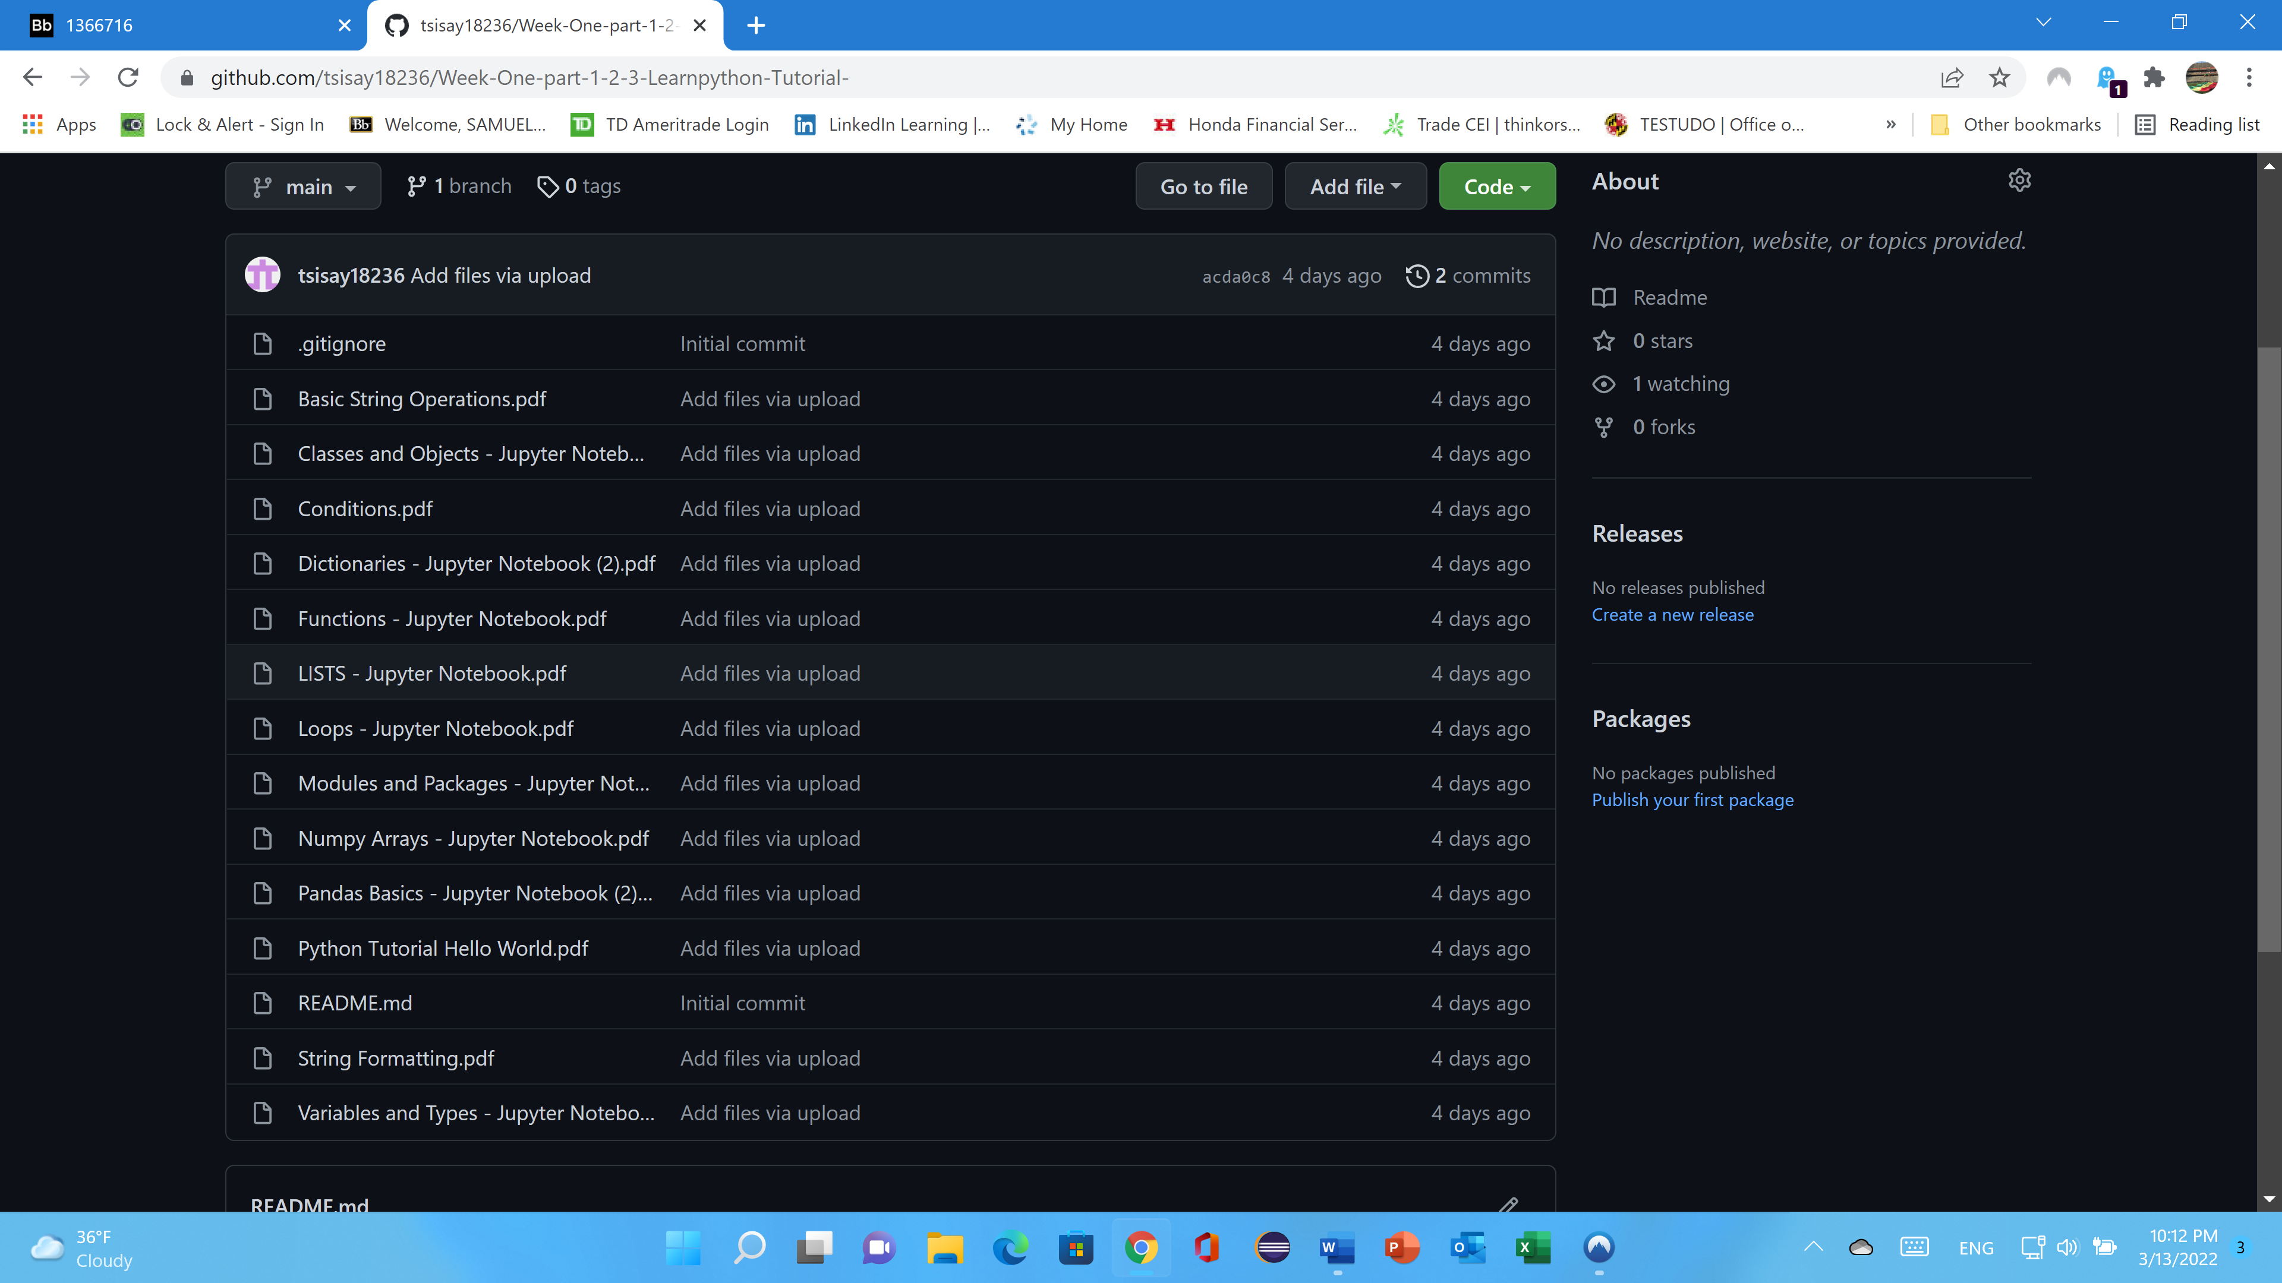
GitHub
Throughout the semester, we used jupyter notebook to visualize CTEC 128 and CTEC 298 data files using various charts,
We uploaded each file to GitHub, Google Drive, and Jupyter notebook to share it with other people.
We then uploaded the code to GitHub and created repositories with descriptions to describe what was happening and what the code would do if run.
The plot deliverables are plots that were created in a jupyter notebook and then ran as python code to display the findings and were plots that our professor assigned to us in CTEC 298 and CTEC 128.
The following image is a screenshot from my GitHub account, which contains all the programming I learned in CTEC 298 week one, from part one to part three, and which I uploaded to my GitHub account…

Slide 18
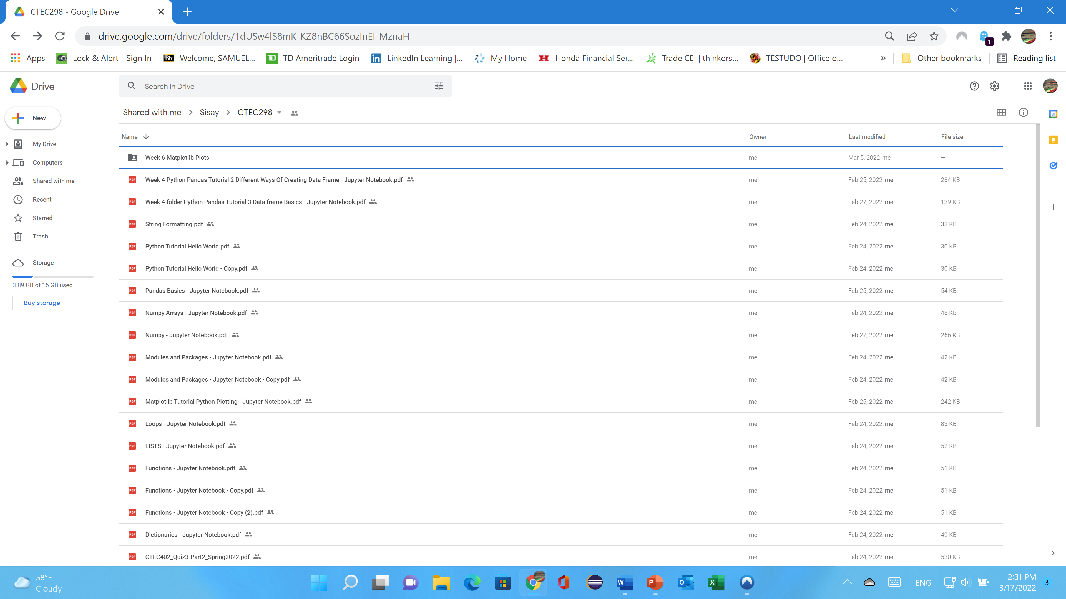
Google Drive
This final project and power point sharing with my professor (Dr. Jesse Bemley).
I have submitted all my document throughout this semester with him. Because the main reason is he will see it what I have done and will correcting me and will give me feedback.
This final project will upload on google drive and GitHub account.
The mean reason I have explain the above and the benefit of sharing my file on google drive is the following.
Google Drive has plenty of advantages, such as easier file sharing and having a remote location to back up your files.
Google Drive's popularity is built on useful collaborative tools and built-in integrations with Google's suite of products and services.
Sharing files: Files are private until you share them.

Slide 19

Summary
Making data-driven judgments is one of Big Data's primary capabilities.
The process of making judgments based on data analysis rather than intuition is known as data-driven decision making.
Rather of making decisions based on previous experiences, the choice is made based on probable future patterns.
It is now possible to predict which products and services will be successful in the marketplace, demonstrating the value of being first to market.
Better professional chances are emerging in datasets all over the universe, and big data analytics is in high demand. Data analysts will become increasingly important in the future.
As a result, the CTEC 298 class (we) has been working on a variety of projects this semester, including a mountain survival meal for kid’s project, and utilizing jupyter notebook to run code and plot graphs.
The concepts and purpose of using Jupyter notebook, understanding of python programming, understanding of basic data science, understanding of use of python libraries such as transform raw data into information by uploading streaming, collecting different types of data such as text file and csv file will be explained.

